Slide 1

Pens & Printers
Presented by: Meihui Wu
Date Presented:
5th Feb 2025

Slide 2
1. Project Overview
Objective: Analyze the sales strategy for the new office stationery product line to identify the most effective methods, maximizing revenue and minimizing effort.
Key Areas:
Evaluate various sales approaches and their impact on revenue and customer engagement.
Identify the best strategy to improve resource efficiency and overall sales performance.
Outcome:
Deliver actionable, data-driven recommendations for selecting optimal sales methods.

Slide 3
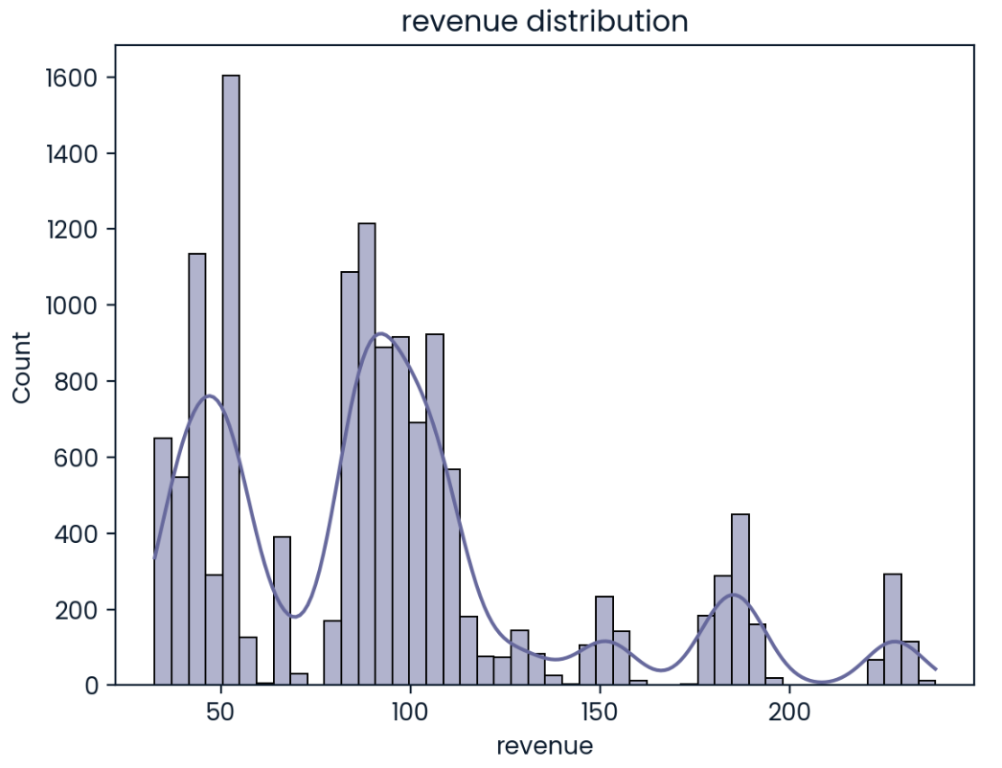
2. Analysis & Insights
The chart shows two main peaks, one around 50
and the other around 100. This indicates that the majority of the revenue is concentrated in these two ranges.

Slide 4
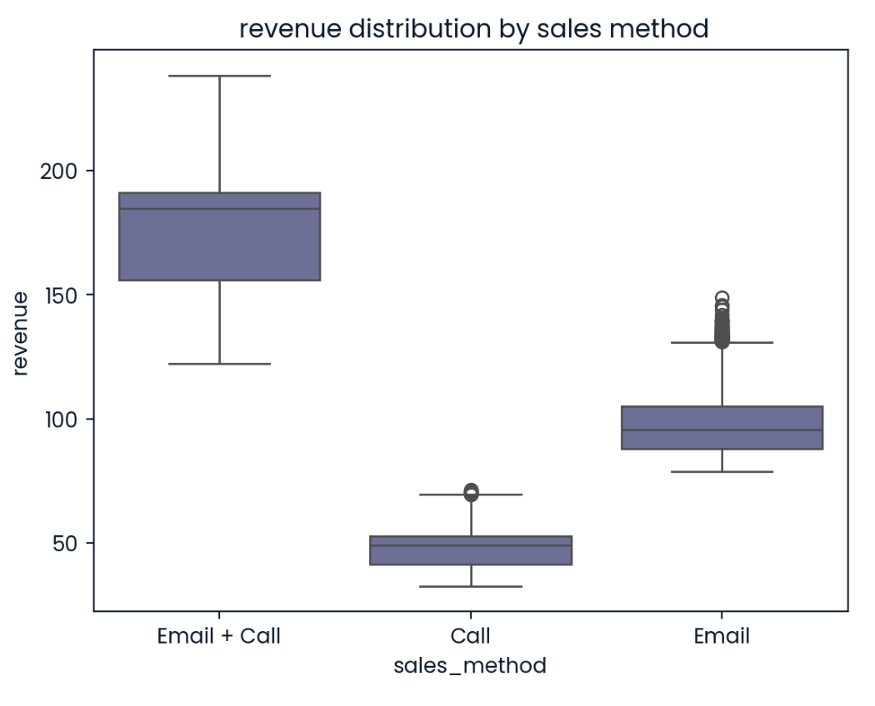
2. Analysis & Insights
Email:
the most time-efficient, although its revenue performance is moderate, it covered our main revenue range.
Call:
the most time-consuming, with lower revenue
Email + Call:
has a moderate time investment and moderate revenue performance.

Slide 5
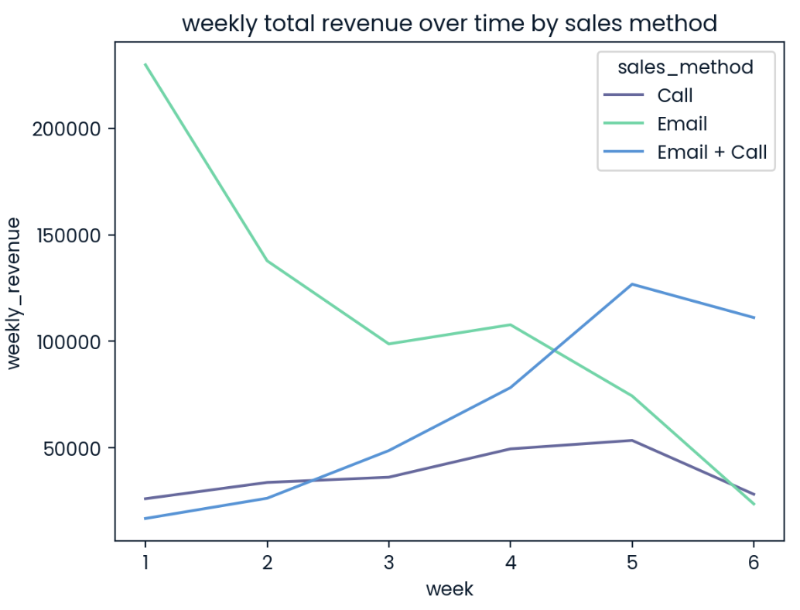
2. Analysis & Insights
Email:
performed well initially, but its revenue declined over time.
Call:
although its revenue gradually increased over time, it still underperformed compared to other methods.
Email + Call:
exhibited significant fluctuations. Initially, the conversion rate was low, resulting in lower revenue, but over time, the sales grew steadily.

Slide 6
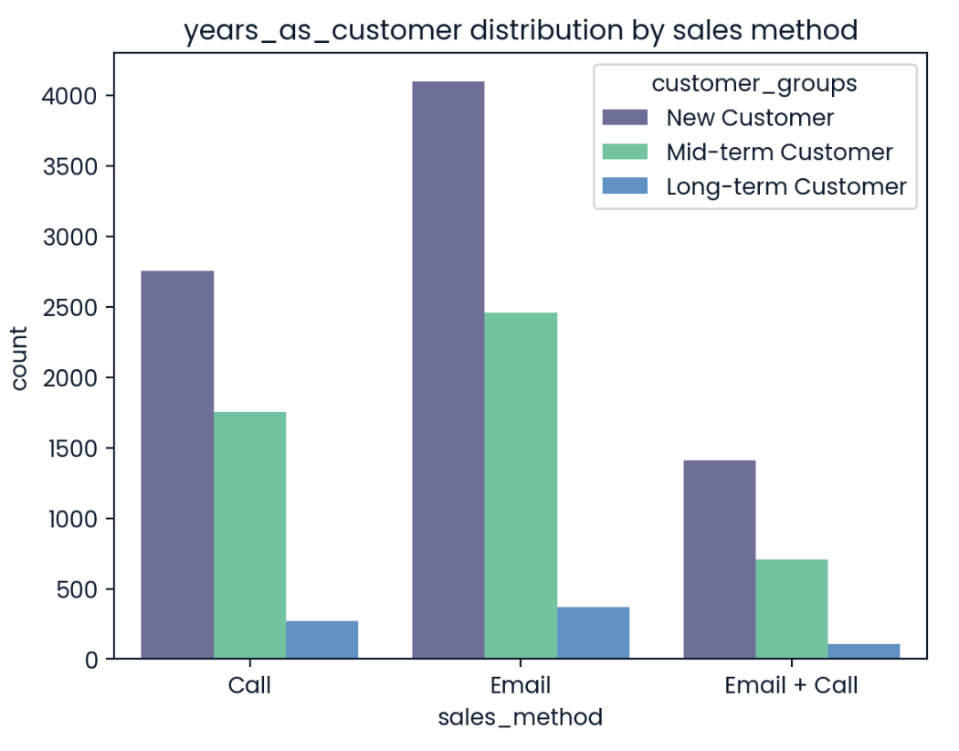
2. Analysis & Insights
Email:
has a relatively balanced customer distribution, attracting new customers as well as a certain proportion of mid-term and long-term customers.
Call:
mainly attracts new customers, but its attracting power is not as strong as the Email method.
Email + Call:
mainly attracts new customers and mid-term customers, with fewer long-term customers.
New customer: 0-5 years as a customer
Mid-term customer: 5-15 years as a customer
Long-term customer: 15-40 years as a customer

Slide 7
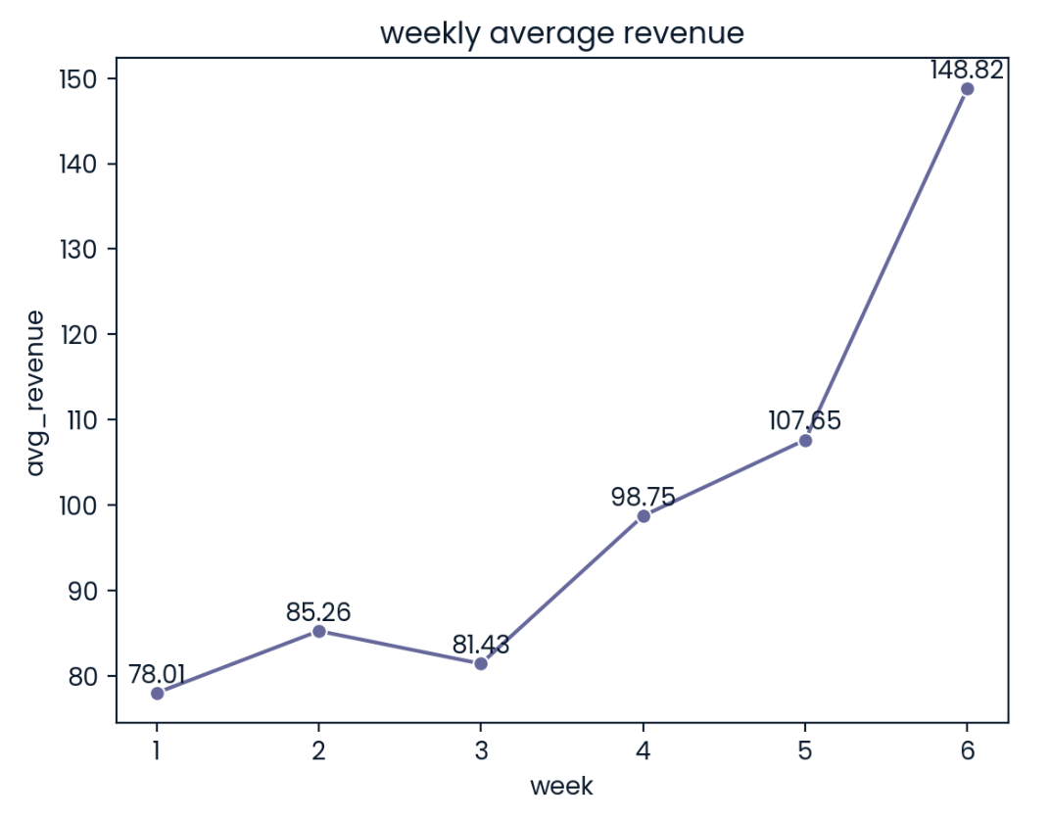
3. Business Metric
Since our goal is to select the most suitable sales method for the new product, we can use the weekly average revenue as a metric. This will help evaluate the effectiveness of the chosen sales method and the rationale behind the sales method selection.
The weekly average revenue values calculated on the right graph serve as the baseline for the metrics based on current data. If the average weekly revenue increases thereafter, it indicates that the chosen sales method is effective.

Slide 8
4. Recommendation
Monitoring Weekly Revenue
Track the weekly average revenue after adopting the Email sales method and compare it to the baseline to assess if there is a consistent increase in revenue.
Selecting Email Method
Based on the analysis, the Email sales method generates the highest revenue, reaches both new and mid to long-term customers effectively, and maximizes efficiency, while the other two methods are costly and underperforming, making them unsuitable.
Focusing on Growth-Driven Methods
Continue using the Email method if revenue shows consistent or increasing growth. If it declines, reassess the strategy and consider optimizing or adjusting the approach.
Evaluating Additional Factors
Monitor customer engagement, retention, and conversion rates alongside revenue to evaluate the sales strategy's effectiveness and guide future adjustments.

Slide 9
Thank You!

